Slide 1
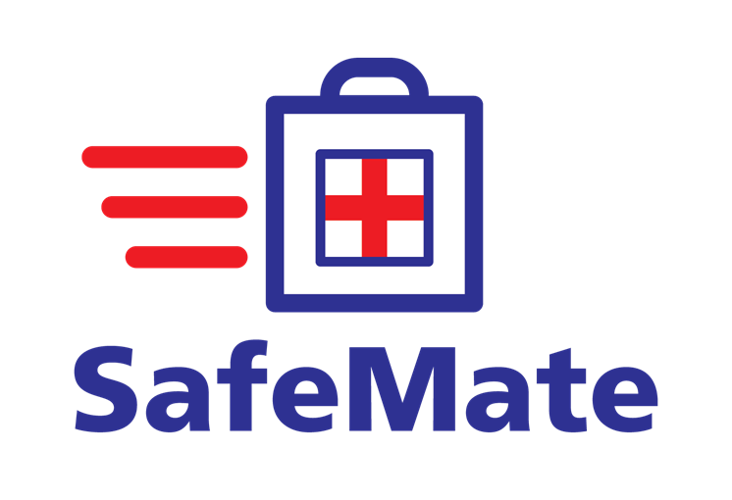
Your Lifeline in a Medical Emergency

Slide 2

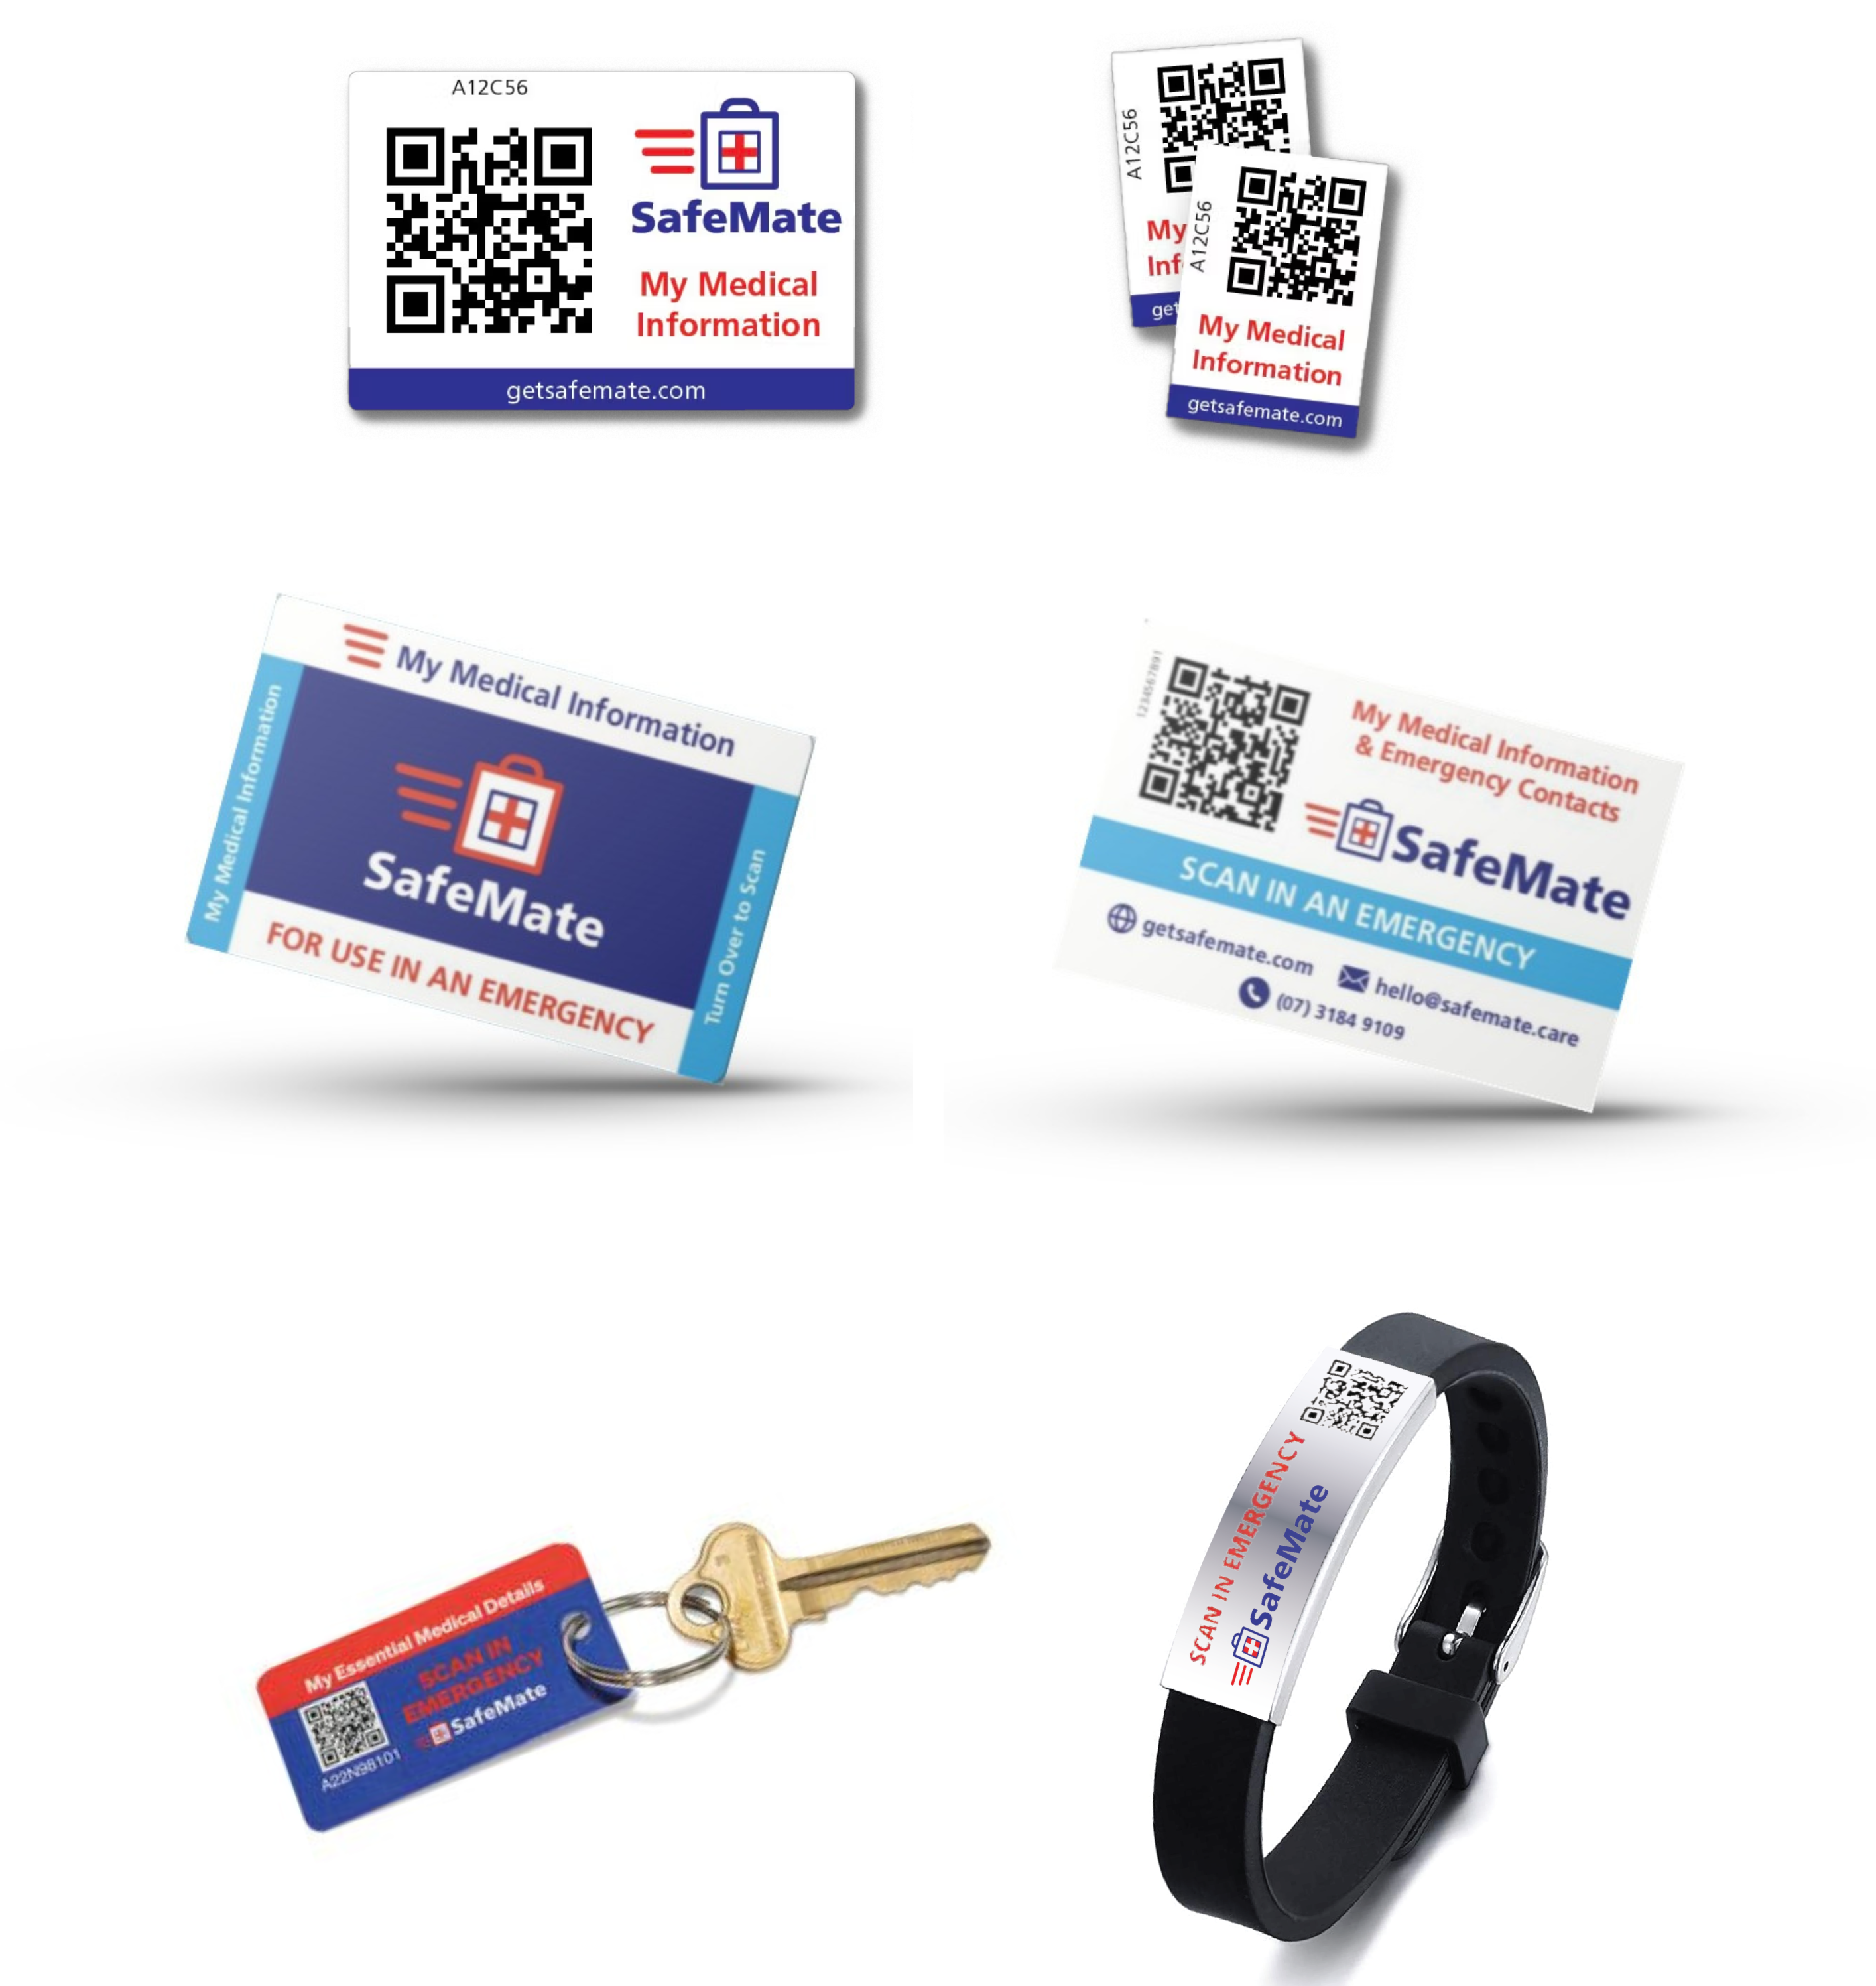
What is SafeMate?
SafeMate is a simple, fast and secure system that instantly gives QAS paramedics your vital medical details in an emergency.
We have had a close partnership with Queensland Ambulance Services since 2017, providing support to Queenslanders through our QR technology and giving paramedics the tools to treat patients the right way, right away.
When an accident or emergency occurs, every second counts. SafeMate is helping to save lives by providing access to a patient’s medical details at the scene of an accident or emergency. Using a personalised QR code to deliver secure medical information to paramedics, patient outcomes are improved by removing delays in receiving appropriate emergency treatment.
SafeMate has, in fact, been proven to save paramedics up to 10 minutes in an emergency.
SafeMate stores all your vital information including:
Emergency contacts eg. family, doctor, specialist
Medications
Allergies
Medical history & existing conditions
Location of EPA & AHD
How to access your property quickly e.g. location of keys/key safe
End of Life wishes
Pet Instructions & other essential details
The SafeMate kit comes with a card, 2 key tags, a fridge magnet, a silicone wristband and 6 stickers that you can place on your
front door, mobile phone, medical alert device, vehicle or anywhere highly visible.

Slide 3
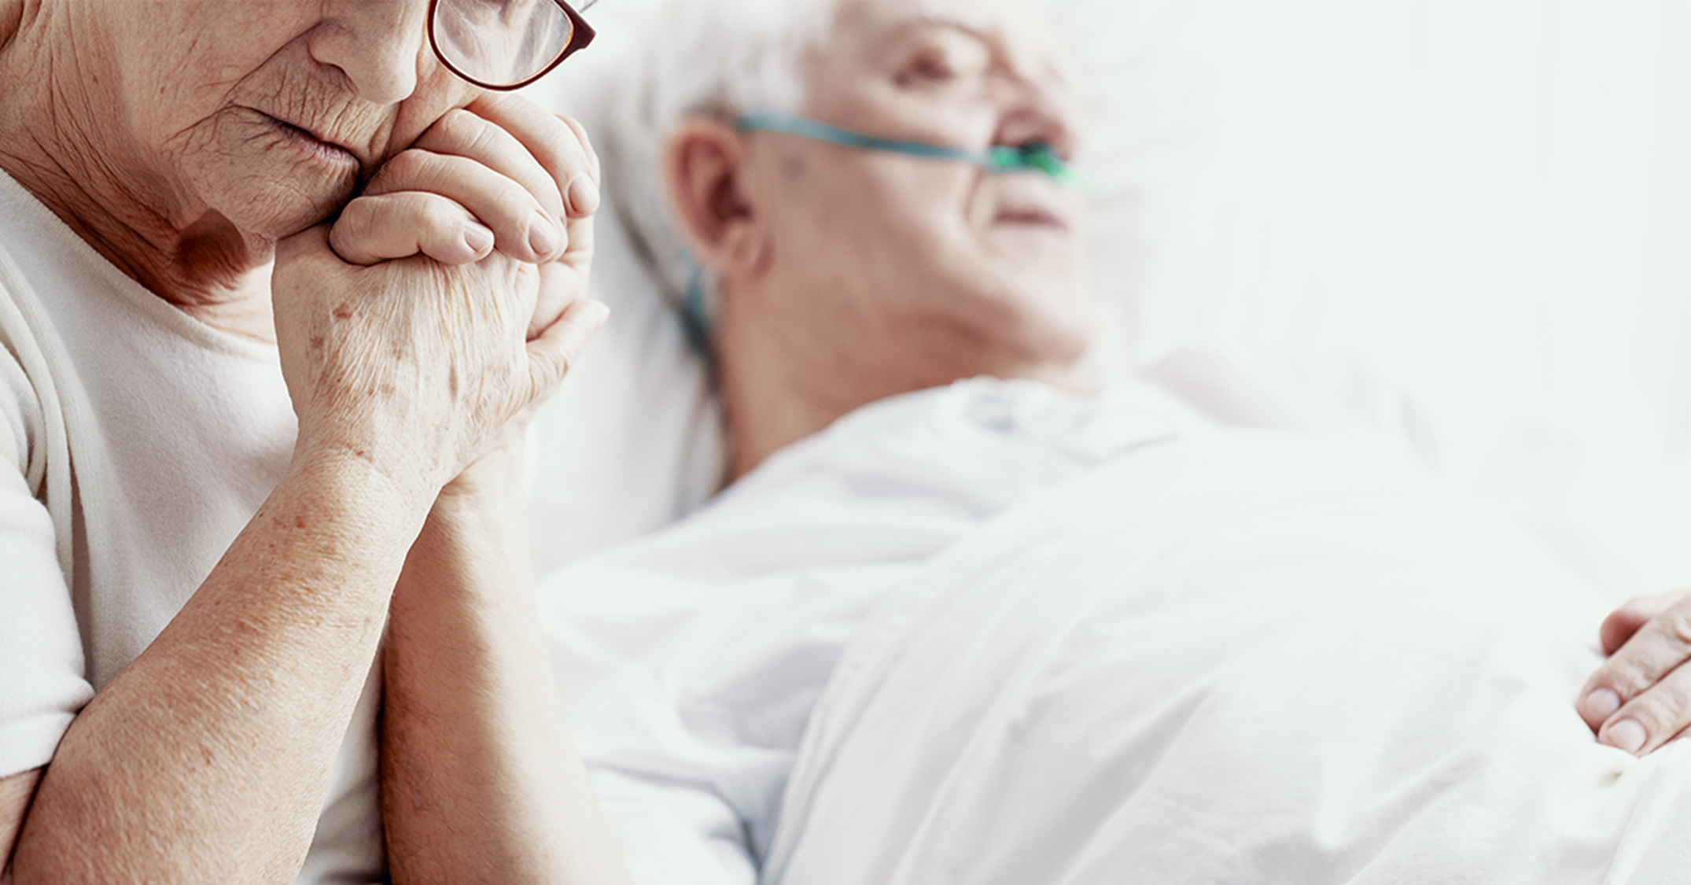
SafeMate is a support system to…
the elderly still living at home
people suffering from chronic conditions
people who are on a long list of medications. Ensures any medical treatment you receive from the paramedics does not have an adverse reaction
people who have allergies eg. Penicillin or Morphine etc. If accidentally administered these can be incredibly detrimental
people who have surgical implants or end of life requests to ensure paramedics are aware of this prior to treatment
people living with a disability
people who are non-verbal
people with mental health issues
young children with allergies or medical conditions
Non-English speaking people
employees working in high risk occupations
Your family, friends or carer. SafeMate takes all the stress away reassuring them that you are in safe hands! Peace of mind for everyone!
SafeMate is there for you! Especially in emergencies in which you are unconscious, disorientated or find it difficult to converse with first-responders.

Slide 4
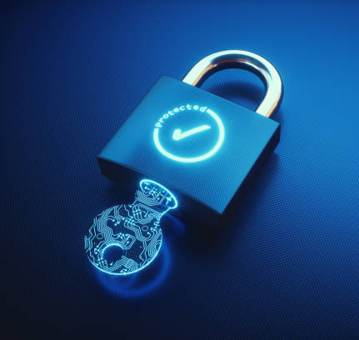
Your personal details are secure:
Your personal details are impossible to access except by you, those authorised by you and by a certified QAS Paramedic.
We have undertaken a rigorous cyber security assessment which has been cleared and approved by a major partner organisation.
The data is encrypted and kept on a secure server within Australia.
Your personal and medical information are kept in a secure database which is password protected.
A certified QAS paramedic can only access your personal details once your SafeMate card is scanned and the paramedic has clicked confirm on the email from our secure system (double authentication).
You have full control and ownership of your data.
Customer data is not used for anything else.
You decide what information you want to share.
You are in total control.
Please see our Privacy Policy for more information on how we protect our data. We are confident that the security measures we have undertaken meet strict guidelines.

Slide 5
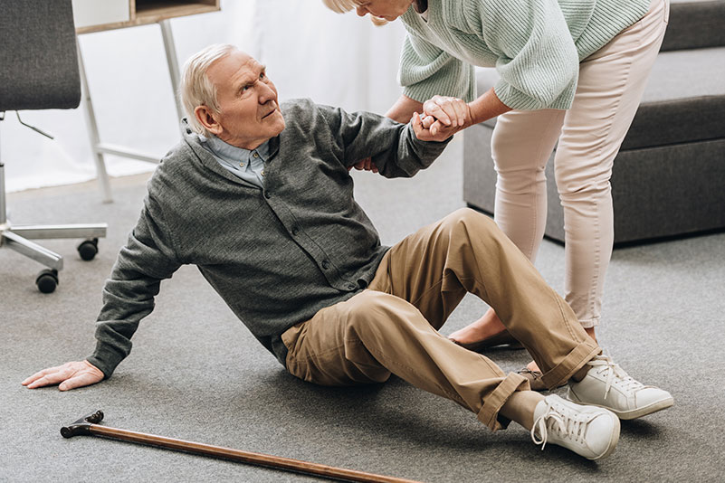
What is the difference?
You have 2 levels of information in your SafeMate Profile: Public and Private
PUBLIC
Information that may assist the general public if they are first to arrive on the scene. This may include:
An emergency contact person to be called i.e. your partner or close contact to let them know of your situation and that help is on the way.
Alerts to Public:
- Patient “trigger” words
- Patient may be deaf or unable to talk
- Patient may be confused if suffering from Dementia
Alerts to important medical conditions e.g. diabetes. This information can help stabilise you prior to the paramedics arriving.
A conversation topic to calm your nerves if you suffer from anxiety prior to the arrival of the paramedics.
PRIVATE
Information only accessible by a QAS paramedic, inclusive of your vital medical and personal details. This may include:
Your medical history and existing conditions
End of life requests
Medications
Allergies
Significant Operations
How to access your property quickly e.g. location of keys/key safe
Your doctor or specialist contacts
If the patient is a War Veteran
Organ donor information
Location of EPA & AHD
Pet Instructions
Should you need to be admitted to a hospital, the paramedics can relay this information to the emergency department.
This Photo by Unknown Author is licensed under CC BY-SA

Slide 6
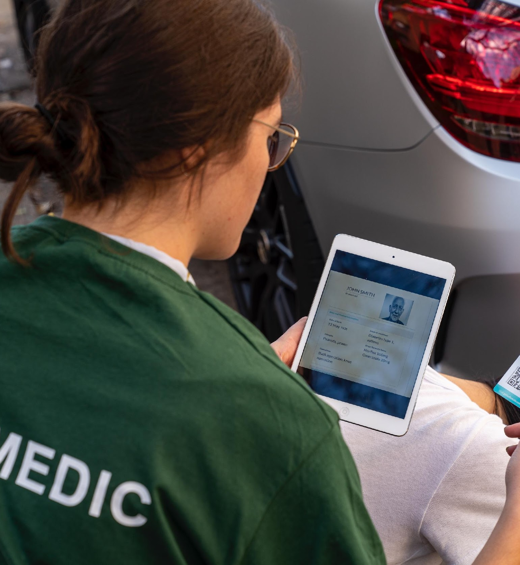
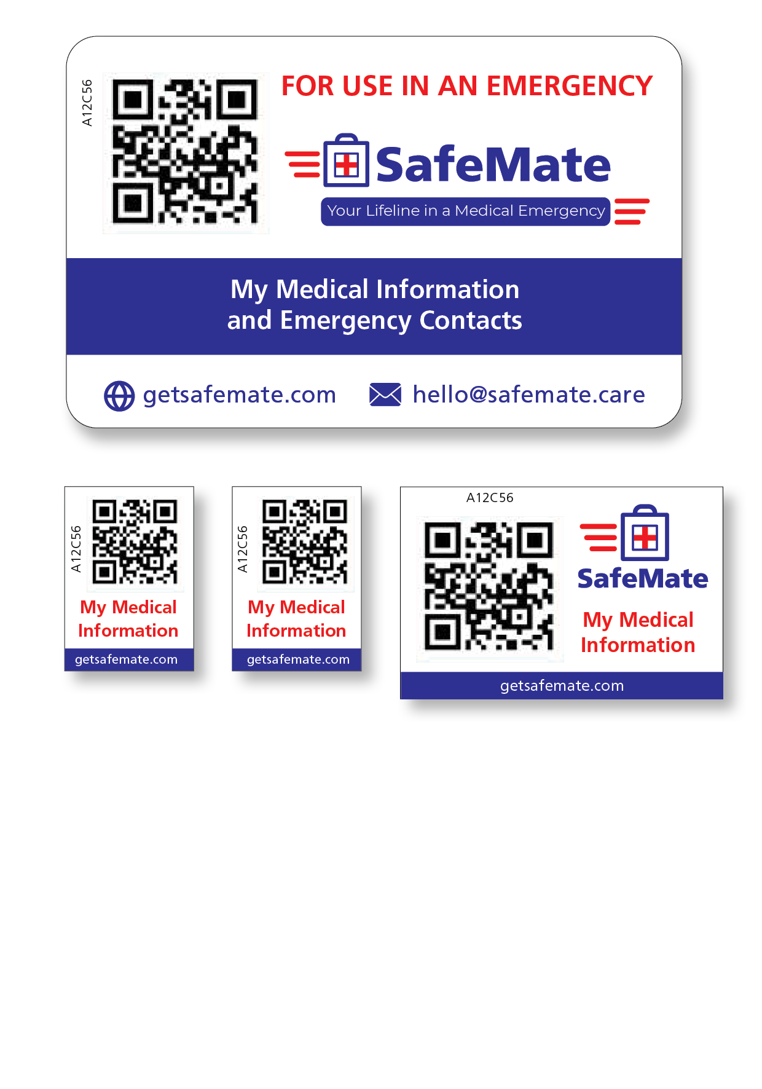
When the QAS paramedics arrive
QAS paramedics are trained to look for medical ID devices eg. SafeMate card, sticker, key tag, fridge magnet or wrist band.
Paramedics scan the QR code, enter their QAS email address which then emails a secure link to their inbox instantly giving them all the patient’s vital details (eg. information that has been pre-loaded into the individual’s secure SafeMate profile by you, a family member or Carer).
SafeMate will speak for you in an emergency!

Slide 7
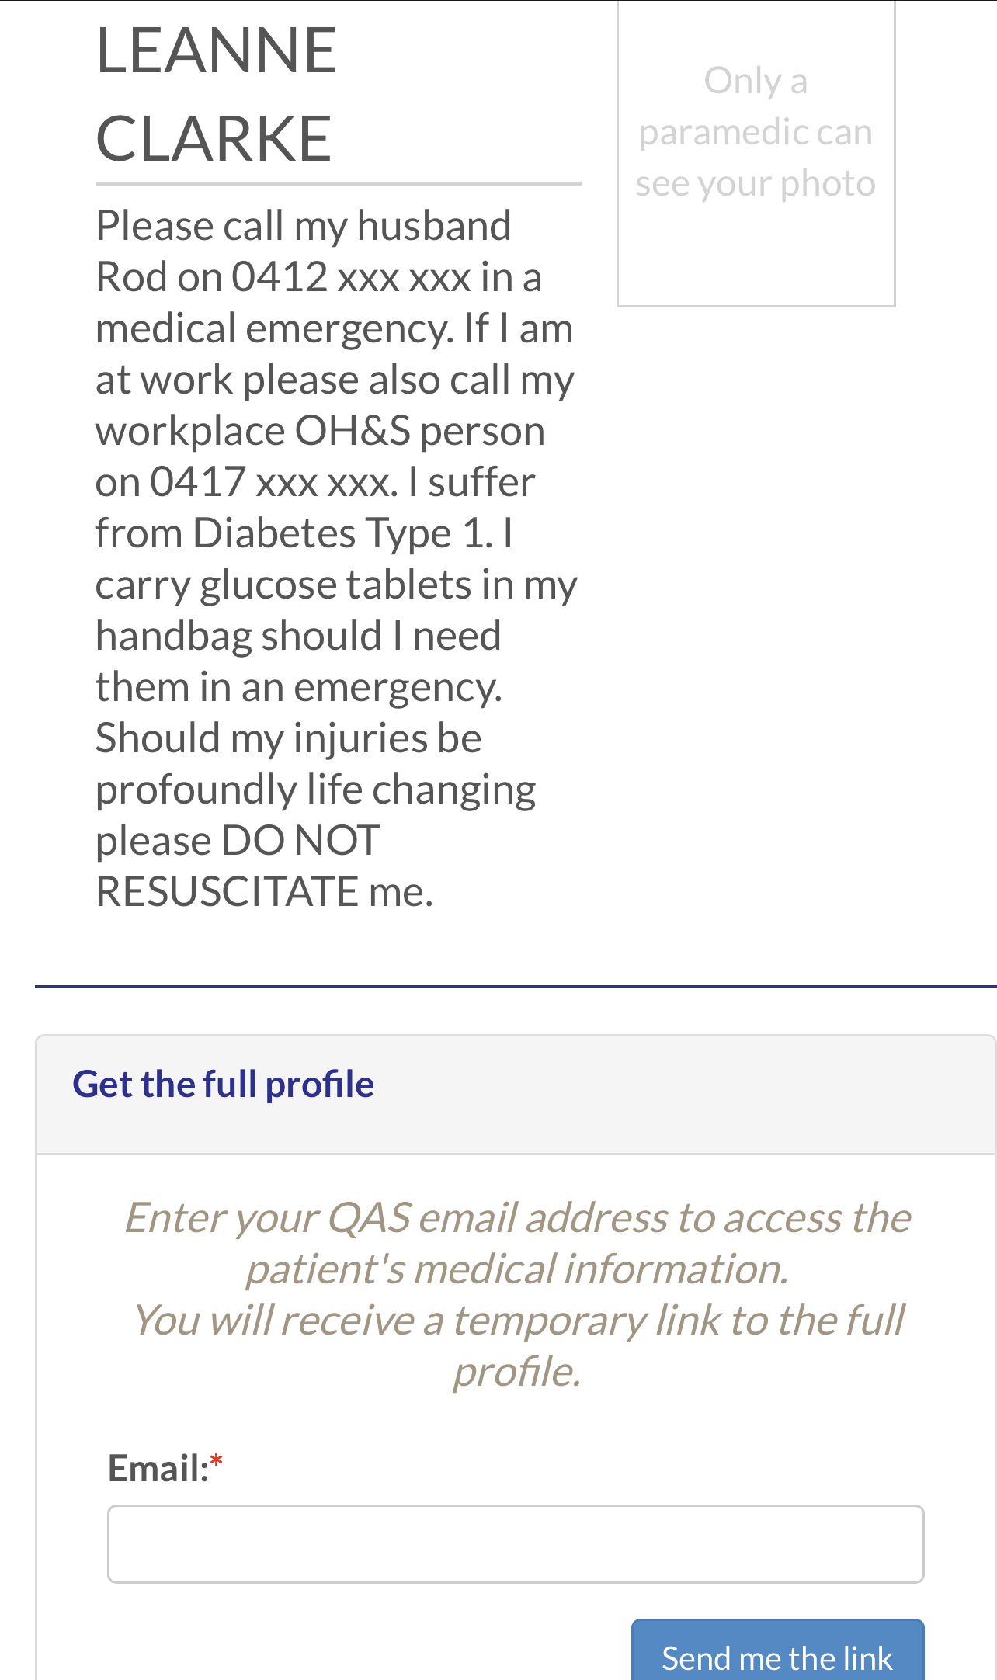
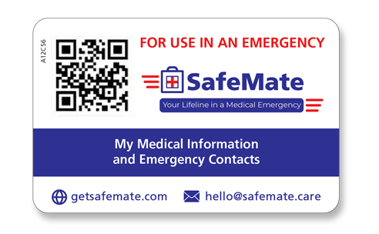
An example of what the general public would see when they scan your QR Code:
PUBLIC:
This Photo by Unknown Author is licensed under CC BY-SA

Slide 8
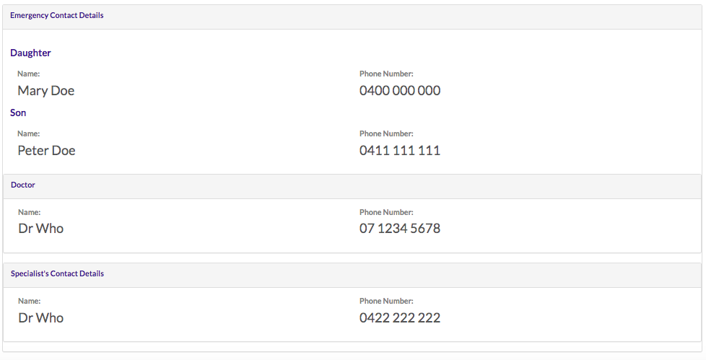
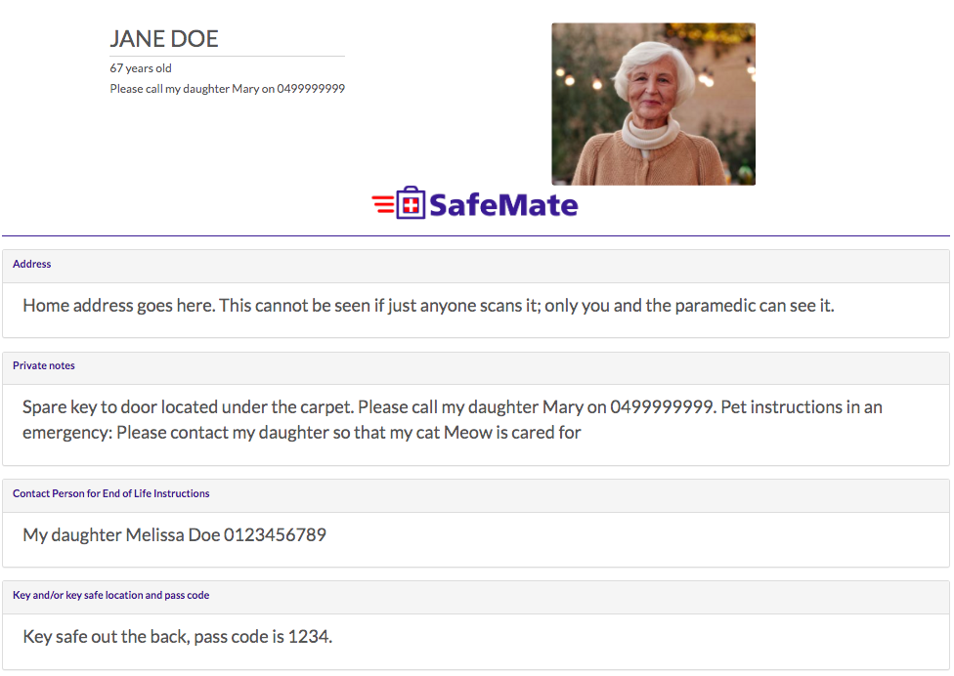
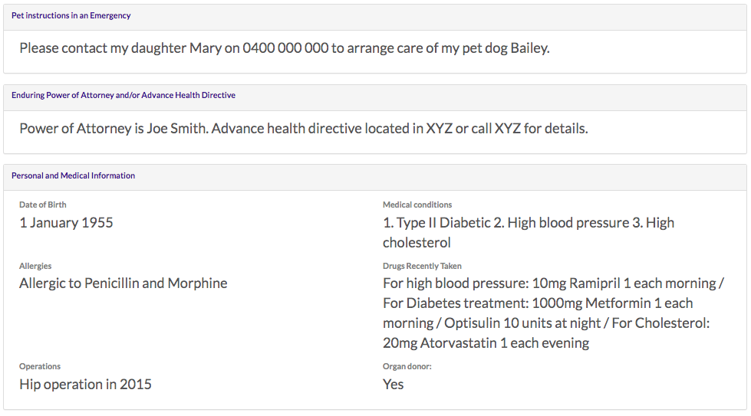
What a Paramedic would see when they scan your QR Code:
PRIVATE:
This Photo by Unknown Author is licensed under CC BY-SA

Slide 9
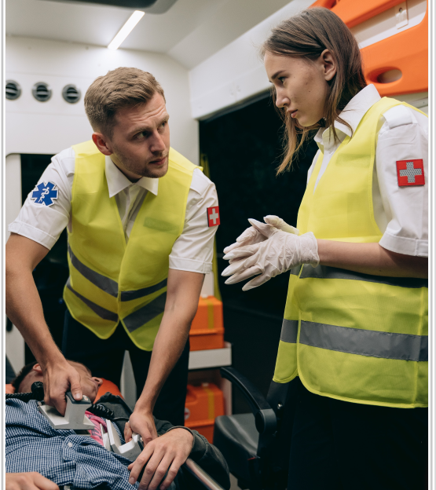



Paramedics know and love SafeMate
Paramedics are able to treat patients
on the spot
Unnecessary trips to hospital are then avoided
Time and time again, precious
time and lives
have been saved
All QAS paramedics have instant, secure access to the data voluntarily provided by SafeMate members.
NOTE: SafeMate is currently only available in Queensland with other States to follow soon.
Should our clients travel interstate or overseas, information can still be accessed from the “Public” field.

Slide 10
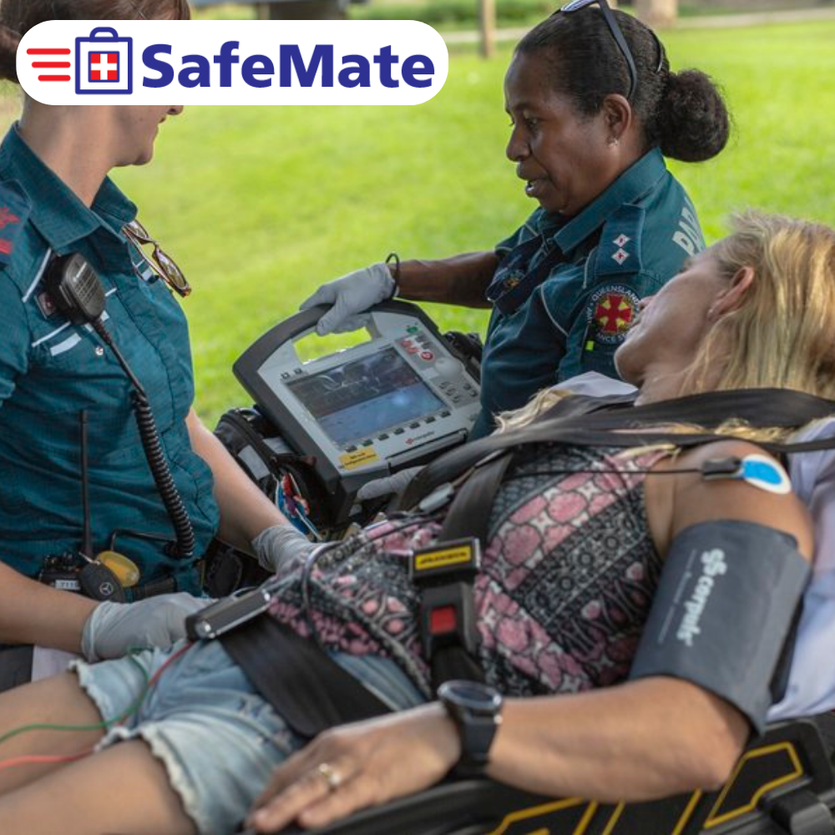
Key Benefits
Speed of access. Crucial vital information is instantly relayed to QAS paramedics to provide fast and effective treatment.
Recognisable technology. Paramedics are trained to recognise SafeMate, meaning reduced patient, family and paramedic stress and confusion at the time of an emergency.
Contacts alerted. You can rest assured knowing QAS paramedics will be able to call your emergency contacts eg. next of kin, family member, doctor or specialist.
Improving outcomes. SafeMate shortens ambulance response times and enhances patient outcomes, saving paramedics up to 10 minutes in a critical situation.
Prevent hospitalisation. Faster response times can prevent costly and unnecessary hospitalisation.
End of life certainty. By providing an end of life contact and instructions, actions can be immediately taken on your behalf.
Peace of mind. Gives peace of mind to the families and friends of the individual, as well as carers.
This Photo by Unknown Author is licensed under CC BY

Slide 11
Feedback from Paramedics:
“SafeMate’s beauty is in it’s instant information when we arrive.”
“SafeMate saved me 10 minutes!”
“Attended for a minor issue but SafeMate provided additional information about their history which was very helpful.”
“The SafeMate QR Code would be very useful should the patient not be able to communicate.”
“Takes the stress away from the patient and family when dealing with medical personnel in a stressful situation.”
“Patient explained he had a poor memory and the SafeMate card had all the information we needed.”
“Adds value if the patient is unconscious, enabling paramedics quick access to medical information.”
“Provided timely information and was easy to use.”

Slide 12
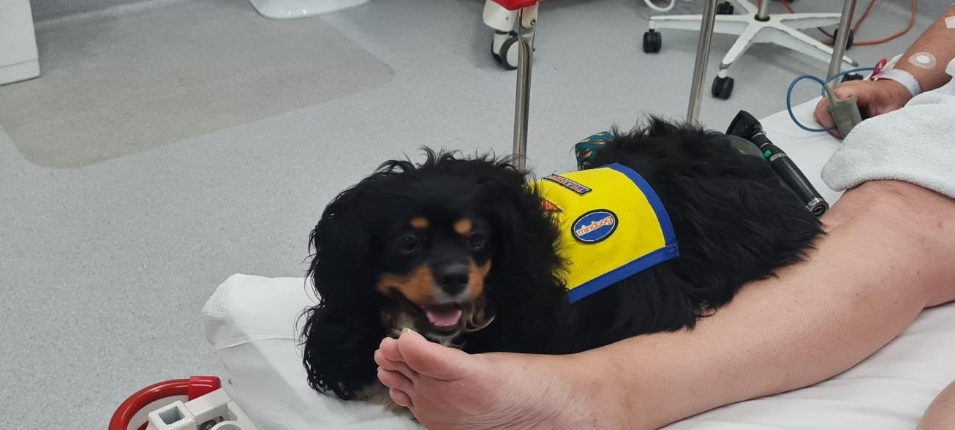
Feedback from our Customers:
“Paramedics wouldn’t have known about my allergy to Morphine if it wasn’t for SafeMate. It could have been a disaster!”
“It [SafeMate] has all the crucial information that I want the paramedics to know.”
“I swear by SafeMate. It is an absolute lifesaver!”
“SafeMate takes all the stress away from me and my family!”
“I always keep it by me for peace of mind. You never know when you might need it.”
“SafeMate makes my life so much easier! It is a godsend.”
“SafeMate is great! The paramedic thought so too!”
“It’s brilliant! Everyone should have one!”
As an Assistance Dog I am so happy that my owner listed me on her SafeMate profile as I was able to accompany her in the ambulance and spent 4 days in hospital with her. The hospital staff really looked after me too but most of all my owner felt safe and secure having me by her side. Thank you SafeMate ☺

Slide 13
What is the cost?
FOR INDIVIDUALS
For an individual, a subscription to SafeMate is $10 per month, $110 per year or $300 for 3 years.
With an annual subscription, this is an investment of 30 cents a day.
And the good news is for those who are eligible, SafeMate can be claimed under the NDIS's Core Support Budget - Assistance with Daily Life - Self Management Capacity Building section. It can also be claimed under "My Aged Care" within the "Assistive Technology - Personal Safety" category.
If you have a letter from your Doctor giving clinical justification of why you should have SafeMate you may have access to DVA funding. DVA will assess this on a case by case basis.
FOR ORGANISATIONS
Be at the forefront of health & safety by providing the latest in digital health technology to your clients/members/employees.
If purchasing SafeMate in bulk on behalf of an organisation, we offer free quotes on a case by case basis.

Slide 14
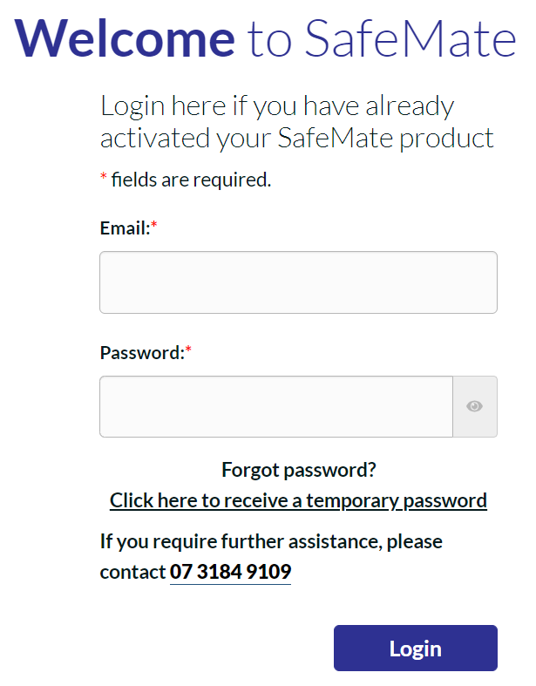
How does one get SafeMate?
Go to www.getsafemate.com
Click on the tab labelled Get SafeMate
Select your subscription period: Monthly, Yearly or 3 Yearly
Click on “Add to Cart” and follow the prompts
How do I activate my account?
All new SafeMate clients receive a Welcome Email with login details. The kit will then be posted to your provided address.
Go to www.getsafemate.com
Click on the tab labelled Member Login and follow the prompts
Enter your medical and contact information and upload your photo
Hit save!
How do I update my account?
Go to www.getsafemate.com
Click on the tab labelled Member Login
Enter your email address and secure password
Note: It is very important that you keep your information up to date, particularly your medications.
If you need assistance, the SafeMate team are happy to help set up your profile for a small charge. All information will be kept confidential.
This Photo by Unknown Author is licensed under CC BY-SA

Slide 15

